Slide 1
Equivalence Class Testing

Slide 2
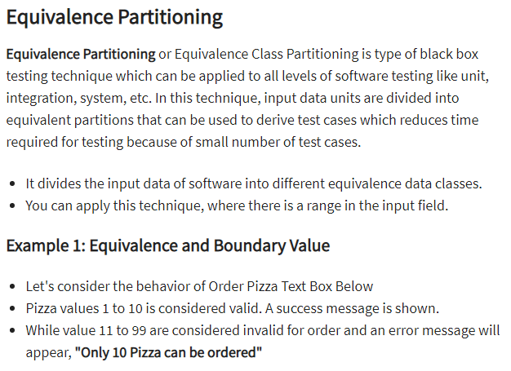

Slide 3
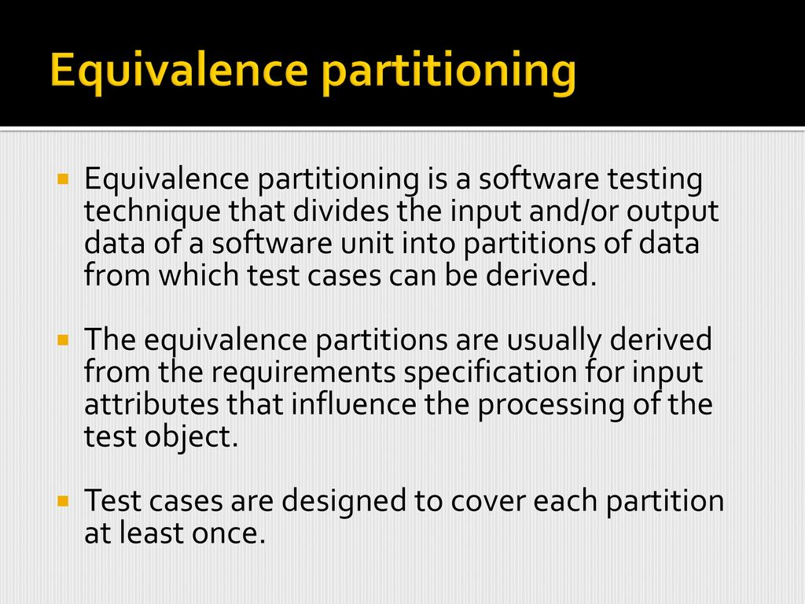
The practice of testing software has become one of the most important aspects of the process of software creation. When we are testing software the first and potentially most crucial step is to design test cases.

Slide 4
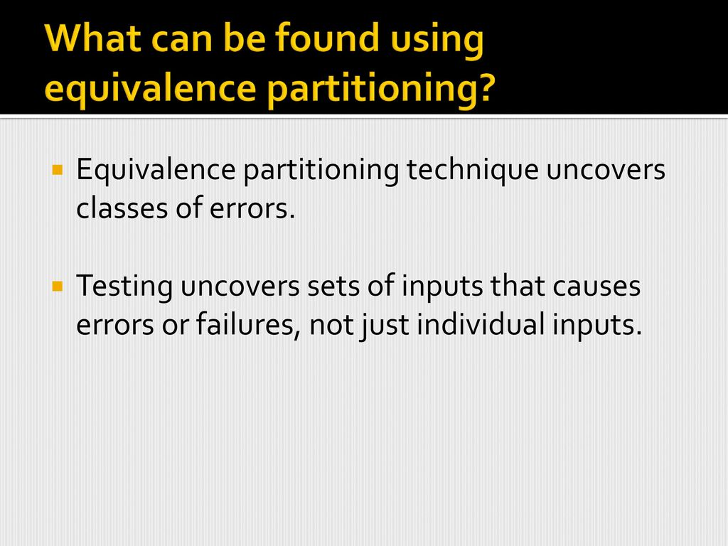

Slide 5
Equivalence Class Testing
Use the mathematical concept of partitioning into equivalence classes to generate test cases for Functional (Black-box) testing
The key goals for equivalence class testing are similar to partitioning:
completeness of test coverage
lessen duplication of test coverage

Slide 6
Equivalence Class Test Cases
Consider a numerical input variable, i, whose values may range from -200 through +200. Then a possible partitioning of testing input variable by 4 people may be:
-200 to -100
-101 to 0
1 to 100
101 to 200
Define “same sign” as the equivalence relation, R, defined over the input variable’s value set, i = {-200 - -,0, - -, +200}. Then one partitioning will be:
-200 to -1 (negative sign)
0 (no sign)
1 to 200 (positive sign)

Slide 7
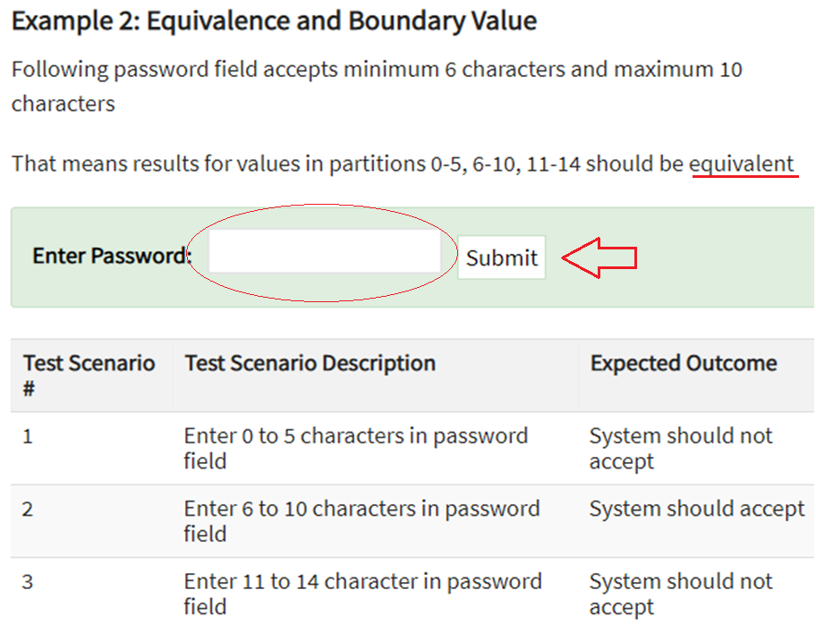

Slide 8
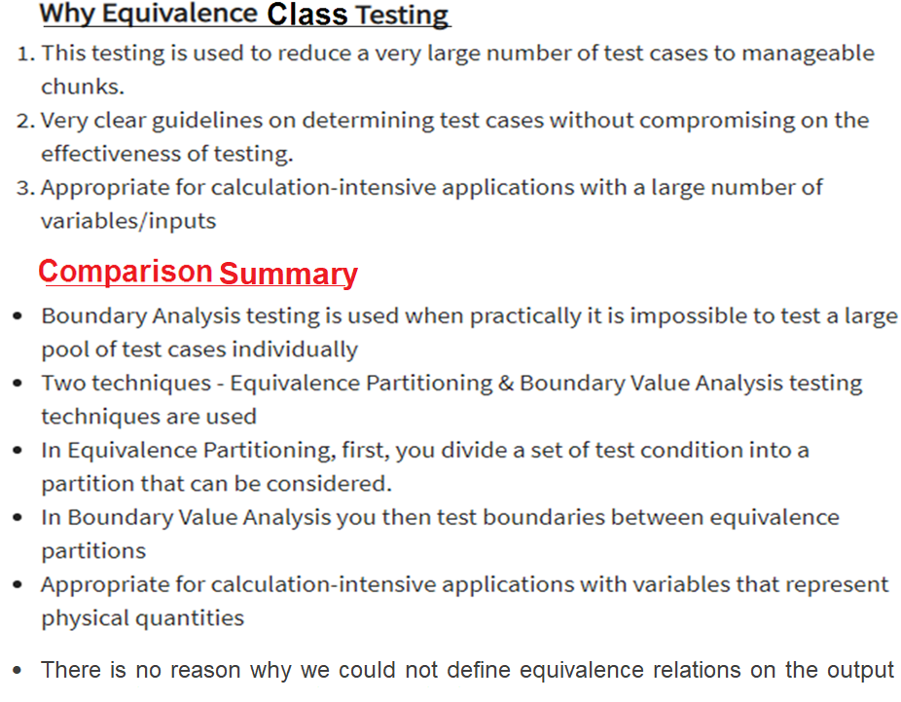

Slide 9
Weak Normal Equivalence testing
Assumes the ‘single fault’ or “independence of input variables.”
e.g. If there are 2 input variables, these input variables are independent of each other.
Partition the test cases of each input variable separately into different equivalent classes.
Choose the test case from each of the equivalence classes for each input variable independently of the other input variable

Slide 10
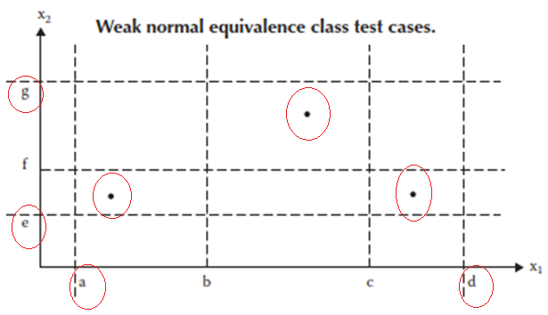
Weak Normal Equivalence Class Testing
Weak normal equivalence class testing is accomplished by using one variable from each equivalence class (interval) in a test case
One test case from one class and for example of total three classes ‘weak normal equivalence class’ testing has 3 test cases shown with dots in Figure below.
The test case in the lower left rectangle corresponds to a value of X1 in the class [a, b) and to a value of X2 in the class [e, f ) and so on

Slide 11
Example of : Weak Normal Equivalence testing
Assume the equivalence partitioning of input X is: 1 to 10; 11 to 20, 21 to 30
and the equivalence partitioning of input Y is: 1 to 5; 6 to 10; 11;15; and 16 to 20
X
We have covered everyone
of the 3 equivalence classes
for input X.
30
20
For ( x, y )
we have:
(24, 2)
(15, 8 )
( 4, 13)
(23, 17)
10
1
Y
1
5
10
15
20
General rule for # of test cases?
What do you think?
# of partitions of the largest set?
We have covered each of the 4 equivalence classes for input Y.

Slide 12
Strong Normal Equivalence testing
This is the same as the weak normal equivalence testing except for
“multiple fault assumption”
or
“dependence among the inputs”
All the combinations of equivalence classes of the variables must be included.

Slide 13
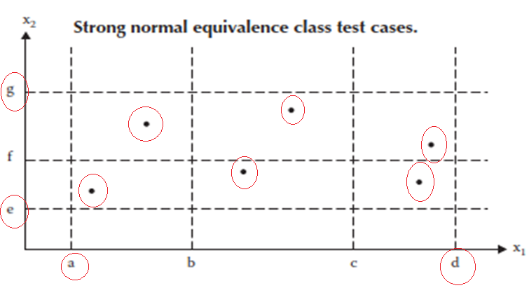
STRONG Normal Equivalence Class Testing
Strong equivalence class testing is based on the multiple fault assumption
We need test cases from each element of the Cartesian product of the equivalence classes, as shown in Figure.
The Cartesian product guarantees that we have a notion of “completeness” in two senses: we cover all the equivalence classes, and we have one of each possible combination of inputs.

Slide 14
Example of : Strong Normal Equivalence testing
Assume the equivalence partitioning of input X is: 1 to 10; 11 to 20, 21 to 30
and the equivalence partitioning of input Y is: 1 to 5; 6 to 10; 11;15; and 16 to 20
X
30
We have covered everyone
of the 3 x 4 Cartesian product of equivalence
classes
20
10
1
Y
1
5
10
15
20
General rule for # of test cases?
What do you think?

Slide 15
Weak Robust Equivalence testing
Up to now we have only considered partitioning the valid input space.
“Weak robust” is similar to “weak normal” equivalence test except that the invalid input variables are now considered.
A note about considering invalid input is that there may not
be any definition “specified” for the various, different invalid
inputs - - - making definition of the output for these invalid
inputs a bit difficult at times. (but fertile ground for testing)

Slide 16
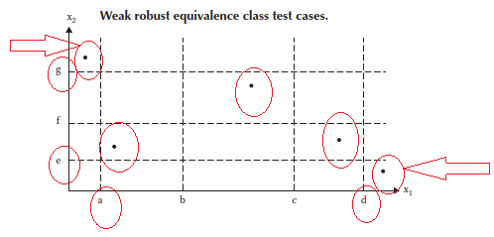
Weak robust Equivalence Class Testing
How something can be both weak and robust?
The robust part comes from consideration of invalid values, and the weak part refers to the single fault assumption.
The process of weak robust equivalence class testing is a simple extension of weak normal equivalence class testing + classes that exceed the bounds(lower, upper)
Then pick one test case from each class , such that robust classes also represented as shown in Figure below.

Slide 17
Example of : Weak Robust Equivalence testing
Assume the equivalence partitioning of input X is 1 to 10; 11 to 20, 21 to 30
and the equivalence partitioning of input Y is 1 to 5; 6 to 10; 11;15; and 16 to 20
X
30
We have covered everyone of the 5 equivalence classes for input X.
20
10
1
Y
1
5
10
15
20
We have covered each of the 6 equivalence classes for input Y.

Slide 18
Strong Robust Equivalence testing
Does not assume “single fault” - - - assumes dependency of input variables
“Strong robust” is similar to “strong normal” equivalence test except that the invalid input variables are now considered.

Slide 19
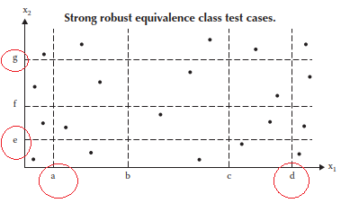
Strong robust Equivalence Class Testing
As usual, the word robust part comes from consideration of invalid values.
The strong part refers to the multiple fault assumption.
We obtain test cases from each element of the Cartesian product in all the equivalence classes,
Both valid and invalid, as shown in Figure below., which consists of most redundant test cases.

Slide 20
Example of : Strong Robust Equivalence testing
Assume the equivalence partitioning of input X is: 1 to 10; 11 to 20, 21 to 30
and the equivalence partitioning of input Y is: 1 to 5; 6 to 10; 11;15; and 16 to 20
X
30
We have covered everyone
of the 5 x 6 Cartesian product of equivalence
classes (including invalid
inputs)
20
10
1
Y
1
5
10
15
20

Slide 21
Equivalence class Definition
Note that the examples so far focused on defining input variables without considering the output variables.
For the earlier “triangle problem,” we are interested in 4 questions:
Is it a triangle?
Is it an isosceles?
Is it a scalene?
Is it an equilateral?
We may define the input test data by defining the equivalence class through “viewing” the 4 output groups:
input sides <a, b, c> do not form a triangle
input sides <a, b ,c> form an isosceles triangle
input sides <a, b, c> form a scalene triangle
input sides <a, b, c> form an equilateral triangle

Slide 22
Consider: Weak Normal Equivalence Test Cases for Triangle Problem
“valid” inputs:
1<= a <= 200
1<= b <= 200
1<= c <= 200
and
for triangle:
a < b + c
b < a + c
c < b + a
inputs
output
a
b
c
Not triangle
35 10 4
Equilateral
35 35 35
Valid Inputs to get
Equilateral
Isosceles
24 24 7
Not
Triangle
Isosceles
Scalene
35 18 24
Scalene

Slide 23
Strong Normal Equivalence Test Cases for Triangle Problem
Since there is no further sub-intervals inside the valid inputs for the 3 sides a, b, and c, are Strong Normal Equivalence is the same as the Weak Normal Equivalence

Slide 24
Weak Robust Equivalence Test Cases for Triangle Problem
<200,200,200>
Now, on top of the earlier 4 normal test cases, include the “invalid” inputs
Valid Inputs
<1, 1, 1>
Equilateral
Include 6 invalid test case in addition to Weak Normal
above: below:
<201, 45, 50 > < -5, 76, 89 >
<45, 204, 78 > < 56, -20, 89 >
<50, 78, 208 > < 56, 89, 0 >
Not
Triangle
Isosceles
Scalene

Slide 25
Strong Robust Equivalence Test Cases for Triangle Problem
Similar to Weak robust, but all combinations of “invalid” inputs must be included to the Strong Normal.
Look at the “cube” figure and consider the corners (two diagonal ones)
a) Consider one of the corners <200,200,200> : there should be (2³ – 1) = 7 cases of “invalids”
< 201, 201, 201 > < 50 , 201, 50 >
< 201, 201, 50 > < 50 , 201, 201 >
< 201, 50 , 201 > < 50, 50 , 201 >
< 201, 50 , 50 >
b) There will be 7 more “invalids” when we consider the other corner , <1,1,1 >:
< 0, 0, 0 > <7, 0, 9 >
< 0, 0, 5 > <8, 0, 0 >
< 0, 10, 0 > <8, 9, 0 >
< 0, 8, 10>

Slide 26
Guidelines and Observations
1. Obviously, the weak forms of equivalence class testing (normal or robust) are not as comprehensive as the corresponding strong forms.
2. If the implementation language is strongly typed (and invalid values cause run-time errors), it makes no sense to use the robust forms.
3.If error conditions are a high priority, the robust forms are appropriate.
4.Equivalence class testing is appropriate when input data is defined in terms of intervals and sets of discrete values. This is certainly the case when system malfunctions can occur for out-of-limit variable values
5. Equivalence class testing is strengthened by a hybrid approach with boundary value testing

Slide 27
Guidelines and Observations
6. Equivalence class testing is indicated when the program function is complex.
7. Strong equivalence class testing makes a presumption that the variables are independent, and the corresponding multiplication of test cases raises issues of redundancy.
8. The difference between the strong and weak forms of equivalence class testing is helpful in the distinction between progression and regression testing.

